Slide 1
MYLEGION: MEMBER MANAGEMENT
Manage LGN and SAL membership. View, edit, print membership card, assign group permission, and email a single member or group of members.
2025

Slide 2
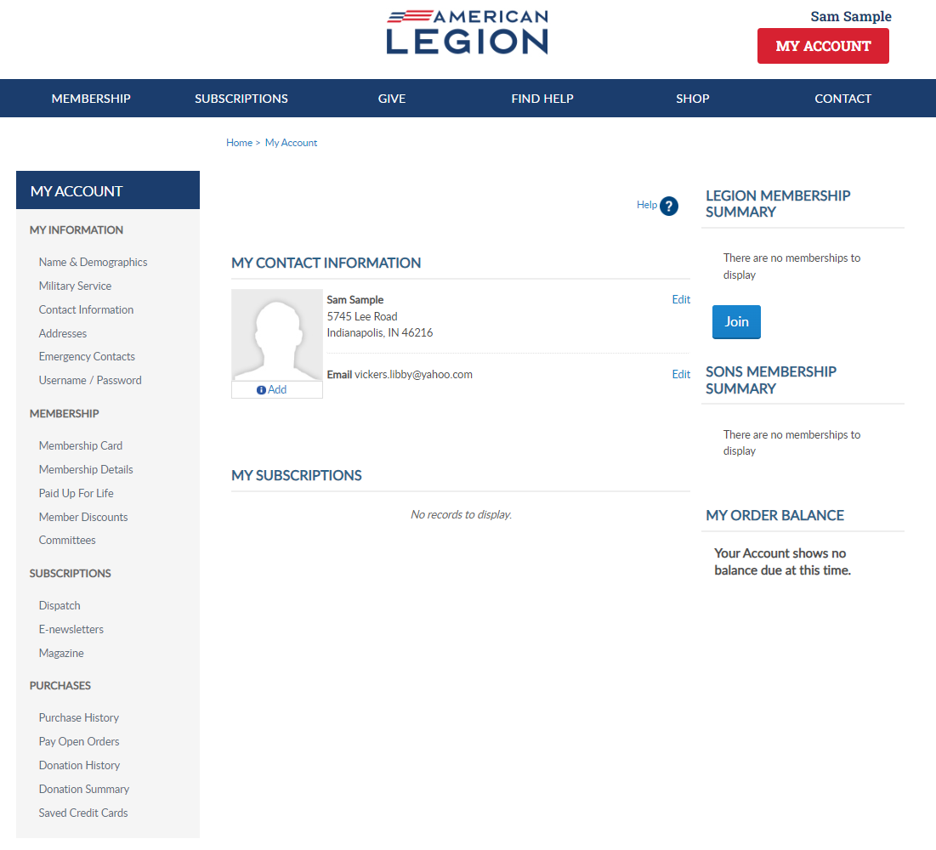
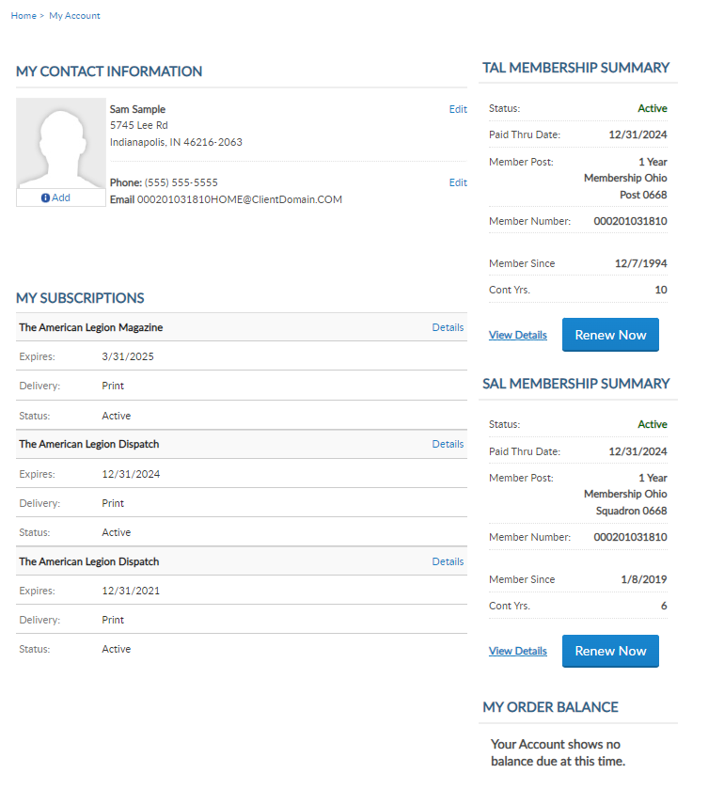
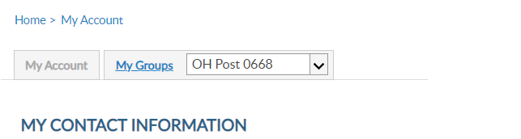
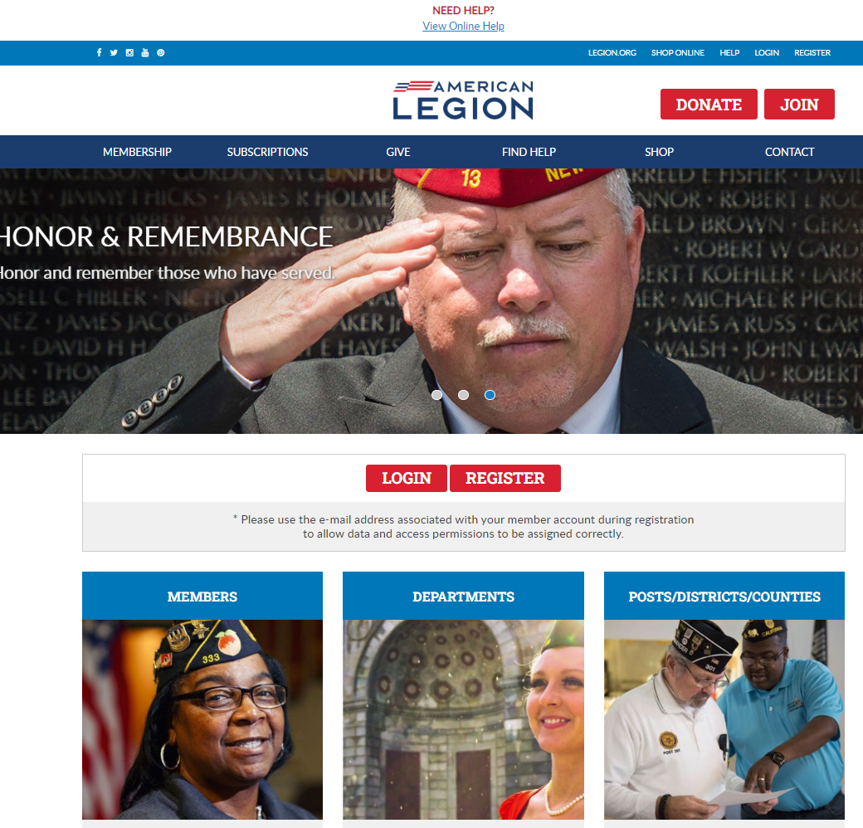

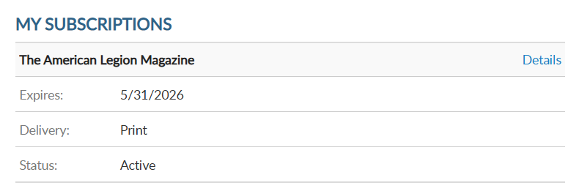
MYLEGION.ORG
emailaddress@yahoo.com
000123456789
Expired
000123456789
Notes:
Administrative membership management tools are available through MyLegion. Begin by logging into MyLegion and proceed to the My Groups menu. My Groups is the administrative side of myLegion available to adjutants and commanders and assigned administrators. If you do not have a My Groups menu and are a current adjutant or commander, contact your department headquarters.

Slide 3
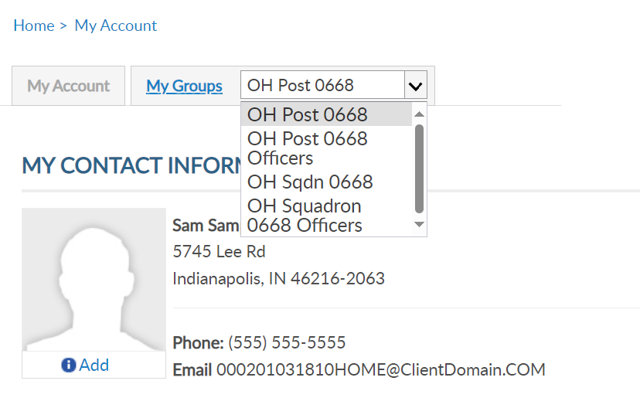
MY GROUPS
Adjutants and Commanders
Legion has LGN and SAL
Officer Groups: view only
emailaddress@yahoo.com
000123456789
Expired
000123456789
emailaddress@yahoo.com
Notes:
My Groups is available from member’s MyLegion accounts when they are recorded as an adjutant or commander of a post, squadron, district, county, department and detachment. Legion leadership have access to both legion and Sons of the American Legion groups. Officer groups are view only. All officers are reported through department headquarters.
This member is a post adjutant. Post adjutants and commanders have access to both post and squadron membership and officer groups.
Clicking on the group will navigate you to the administrative side of MyLegion, group profile.

Slide 4
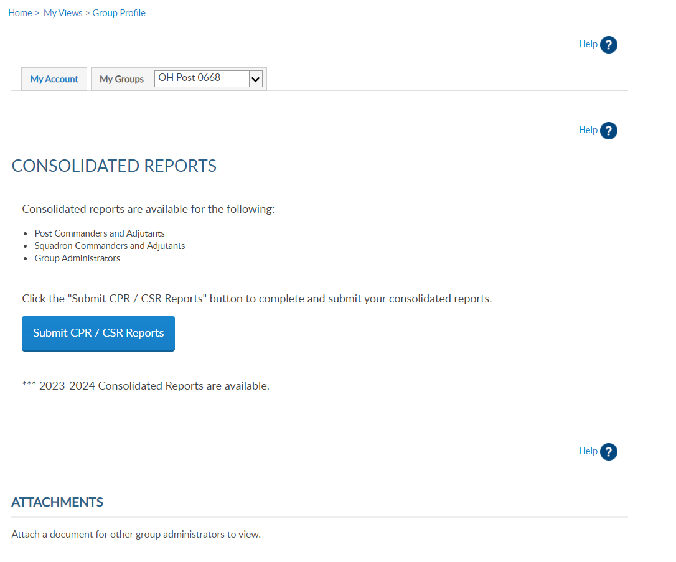
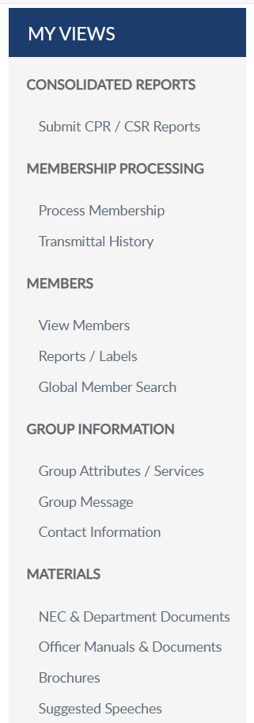
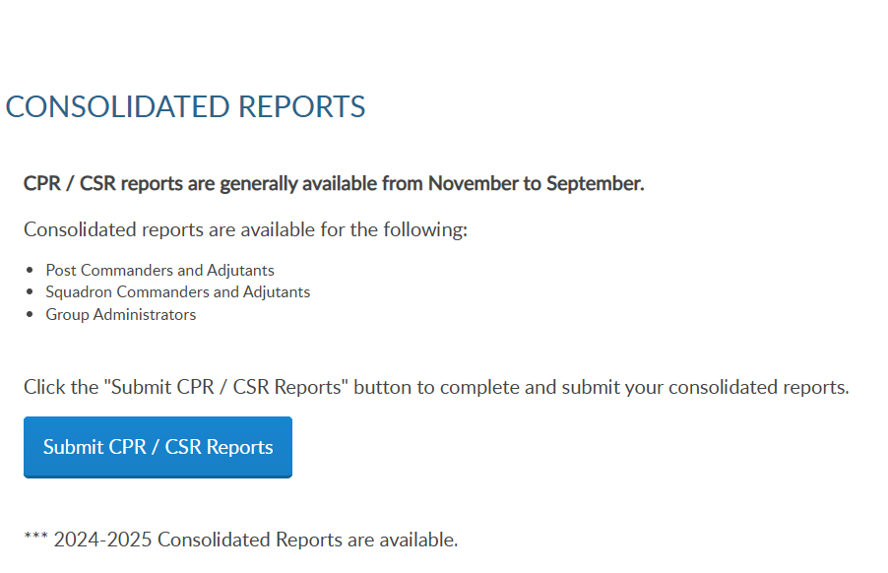
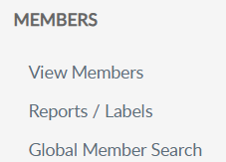
GROUP PROFILE
Notes:
The group profile window includes a menu with administrative tools. View and manage member information using “View Members”. <1> View Members takes you to the membership list.​

Slide 5
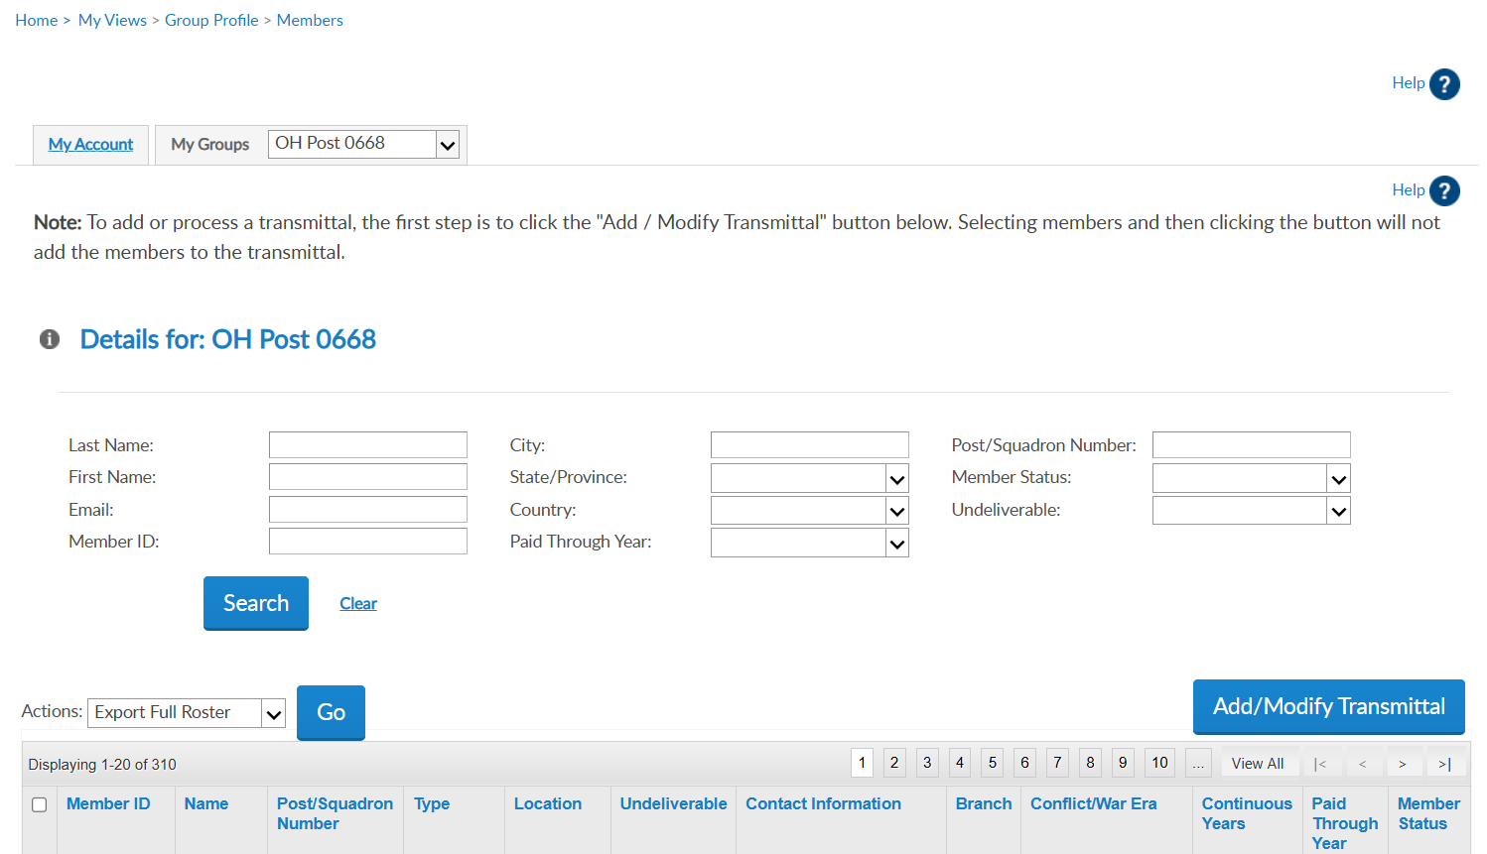

123456781 | AaExample, James | American Legion OH Post 0668 | 1 Year Mbrship | Address |  | email address Phone | USAF | VIETNAM | 5 | 2024 | Expired
123456782 | AaExample, Jr, Fred | American Legion OH Post 0668 | PUFL renewal | Address |  | Phone | USAF | KOREA | 49 | 2025 | Active
123456783 | AaSample, Allen | American Legion OH Post 0668 | 1 Year Mbrship | Address |  | email address Phone | USA | VIETNAM | 20 | 2027 | Active
102222456
Notes:
View members displays current, expired and deceased members.
Search options allow you to search an individual record or a group of members.
<1> This page displays a Add/Modify Transmittal button for post and squadron groups for online membership processing. This is also the location to email a member or group of members.

Slide 6
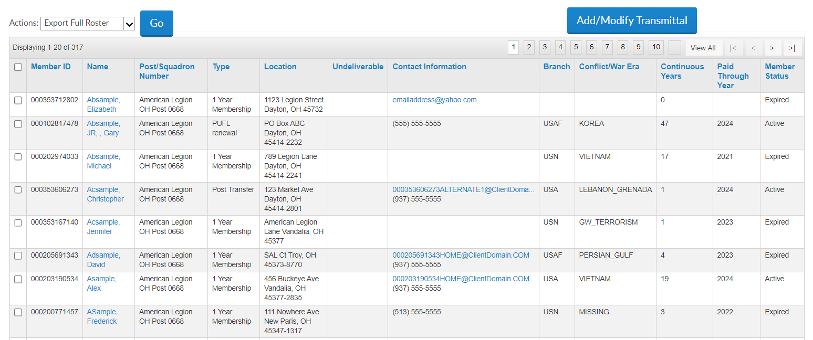
View Members List
123456781 | AaExample, James | American Legion OH Post 0668 | 1 Year Mbrship | Address |  | email address Phone | USAF | VIETNAM | 5 | 2024 | Expired
123456782 | AaExample, Jr, Fred | American Legion OH Post 0668 | PUFL renewal | Address |  | Phone | USAF | KOREA | 49 | 2025 | Active
123456783 | AaSample, Allen | American Legion OH Post 0668 | 1 Year Mbrship | Address |  | email address Phone | USA | VIETNAM | 20 | 2027 | Active
123456784 | AaSample2, Alex | American Legion OH Post 0668 | 1 Year Mbrship | Address | * |  | USN | GW_TERRORISM | 1 | 2023 | Expired
123456785 | AbExample, Kathy | American Legion OH Post 0668 | 1 Year Mbrship | Address |  | email address | USA | OTHER | 0 | 2025 | Active
123456789 | AcSample, Christopher | American Legion OH Post 0668 | 1 Year Mbrship | Address |  | email address Phone | USMC | PERSIAN_GULF | 1 | 2025 | Active
123456787 | AcSample, Jesse | American Legion OH Post 0668 | 1 Year Mbrship | Address |  | email address | USA | GW_TERRORISM | 1 | 2023 | Expired
123456788 | AdExample, Johnathan | American Legion OH Post 0668 | Department Life | Address |  |  |  | VIETNAM | 42 | 2025 | Active
New Member in Pending Transmittal
Notes:
The member list includes current, deceased and expired members. It does not include members who have transferred out.
The view members list is alphabetical. <1> Click on any of the title columns and navigation icons to sort and go from page to page.
<2> New members in a pending transmittal is assigned a member ID# and will be in the list as expired with zero continuous years. This information updates when the transmittal completes. ​​

Slide 7
Contact Info and Undeliverable
123456781 | AaExample, James | American Legion OH Post 0668 | 1 Year Mbrship | Address |  | email address Phone | USAF | VIETNAM | 5 | 2024 | Expired
123456782 | AaExample, Jr, Fred | American Legion OH Post 0668 | PUFL renewal | Address |  | Phone | USAF | KOREA | 49 | 2025 | Active
123456783 | AaSample, Allen | American Legion OH Post 0668 | 1 Year Mbrship | Address |  | email address Phone | USA | VIETNAM | 20 | 2027 | Active
123456784 | AaSample2, Alex | American Legion OH Post 0668 | 1 Year Mbrship | Address | * |  | USN | GW_TERRORISM | 1 | 2023 | Expired
123456785 | AbExample, Kathy | American Legion OH Post 0668 | 1 Year Mbrship | Address |  | email address | USA | OTHER | 0 | 2025 | Active
123456789 | AcSample, Christopher | American Legion OH Post 0668 | 1 Year Mbrship | Address |  | email address Phone | USMC | PERSIAN_GULF | 1 | 2025 | Active
123456787 | AcSample, Jesse | American Legion OH Post 0668 | 1 Year Mbrship | Address |  | email address | USA | GW_TERRORISM | 1 | 2023 | Expired
123456788 | AdExample, Johnathan | American Legion OH Post 0668 | Department Life | Address |  |  |  | VIETNAM | 42 | 2025 | Active
Notes:
The view member list includes member contact and demographic information, last paid membership year and status. Members who have transferred out, will not be included in the list. Addresses that are flagged as undeliverable are indicated by an asterisk. <1> Members with an undeliverable address do not receive renewal notices, TAL magazine, or any other mailed publications.

Slide 8
DISTRICT AND COUNTY
VIEW ONLY
123456781 | AaExample, James | American Legion OH Post 0668 | 1 Year Mbrship | Address |  | email address Phone | USAF | VIETNAM | 5 | 2024 | Expired
123456782 | AaExample, Jr, Fred | American Legion OH Post 0787 | PUFL renewal | Address |  | Phone | USAF | KOREA | 49 | 2025 | Active
123456783 | AaSample, Allen | American Legion OH Post 0776 | 1 Year Mbrship | Address |  | email address Phone | USA | VIETNAM | 20 | 2027 | Active
123456784 | AaSample2, Alex | American Legion OH Post 0613 | 1 Year Mbrship | Address | * |  | USN | GW_TERRORISM | 1 | 2023 | Expired
123456785 | AbExample, Kathy | American Legion OH Post 0668 | 1 Year Mbrship | Address |  | email address | USA | OTHER | 0 | 2025 | Active
123456789 | AcSample, Christopher | American Legion OH Post 668 | 1 Year Mbrship | Address |  | email address Phone | USMC | PERSIAN_GULF | 1 | 2025 | Active
123456787 | AcSample, Jesse | American Legion OH Post 0667 | 1 Year Mbrship | Address |  | email address | USA | GW_TERRORISM | 1 | 2023 | Expired
123456788 | AdExample, Johnathan | American Legion OH Post 0613 | Department Life | Address |  |  |  | VIETNAM | 42 | 2025 | Active
Notes:
District and County access allows view only and include members from all posts or squadrons in your group. District and County access will not include Add/Modify transmittal.

Slide 9
Edit
123456781 | AaExample, James | American Legion OH Post 0668 | 1 Year Mbrship | Address |  | email address Phone | USAF | VIETNAM | 5 | 2024 | Expired
123456782 | AaExample, Jr, Fred | American Legion OH Post 0668 | PUFL renewal | Address |  | Phone | USAF | KOREA | 49 | 2025 | Active
123456783 | AaSample, Allen | American Legion OH Post 0668 | 1 Year Mbrship | Address |  | email address Phone | USA | VIETNAM | 20 | 2027 | Active
123456784 | AaSample2, Alex | American Legion OH Post 0668 | 1 Year Mbrship | Address | * |  | USN | GW_TERRORISM | 1 | 2023 | Expired
123456785 | AbExample, Kathy | American Legion OH Post 0668 | 1 Year Mbrship | Address |  | email address | USA | OTHER | 0 | 2025 | Active
123456789 | AcSample, Christopher | American Legion OH Post 0668 | 1 Year Mbrship | Address |  | email address Phone | USMC | PERSIAN_GULF | 1 | 2025 | Active
123456787 | AcSample, Jesse | American Legion OH Post 0668 | 1 Year Mbrship | Address |  | email address | USA | GW_TERRORISM | 1 | 2023 | Expired
123456788 | AdExample, Johnathan | American Legion OH Post 0668 | Department Life | Address |  |  |  | VIETNAM | 42 | 2025 | Active
Notes:
​To edit member information, click on the member’s name.
​
​

Slide 10
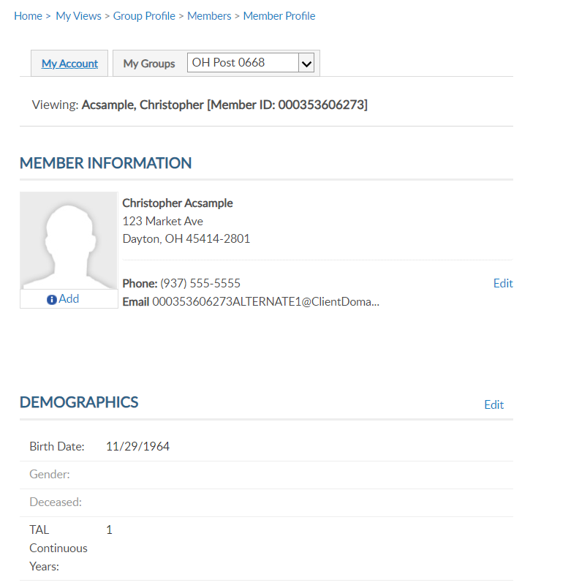
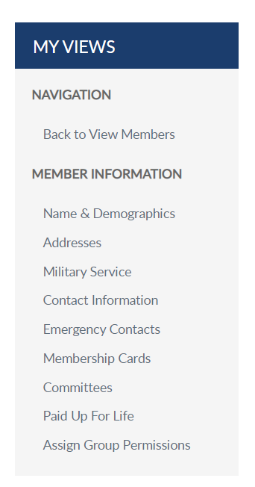
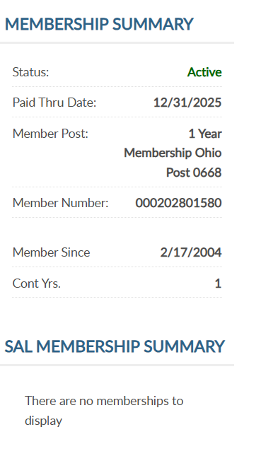
MEMBER INFORMATION
Viewing: Acsample, Christopher [Member ID: 123456789]
Christopher@yahoo.com
000123456789
Notes:
Viewing a member displays the member’s name, ID#, contact information, demographics, and membership summaries. For members of both The American Legion and Sons of the American Legion, both membership summaries are displayed. <1>Summaries include status, paid through year, membership type, and continuous years. The membership ID number is the same for both memberships.

Slide 11
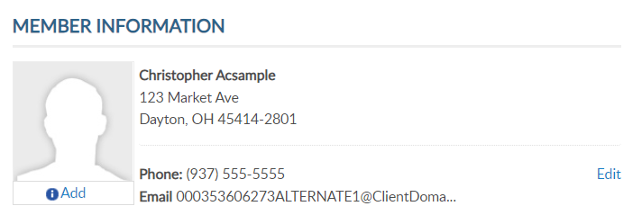
C0NTACT INFORMATION
Viewing: Acsample, Christopher [Member ID: 123456789]
Christopher@yahoo.com
Christopher@yahoo.com
Notes:
Contact information includes phone number and email address. You can edit or add contact information by clicking the edit button in member information <1>. You can also select the link from the side menu.

Slide 12
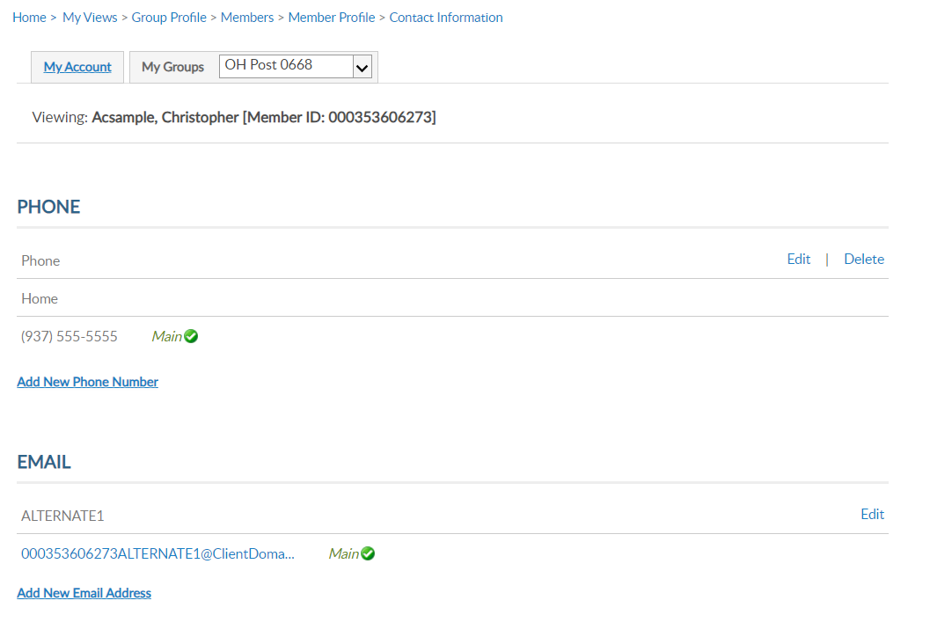
CONTACT INFORMATION
Viewing: Acsample, Christopher [Member ID: 123456789]
Viewing: Acsample, Christopher [Member ID: 123456789]
Christopher@yahoo.com
Notes:
Use, edit, delete or add update as needed.
Member’s can have multiple emails and phone numbers. A total of 3 emails can be on a member’s record.
Updating the main email addresses updates the email associated with your myLegion account. All email communications for myLegion password and username are sent to the main address.
If one email is on file, no delete option will be available. An email must exist on your record to have a myLegion account. In the event you do want to delete your email address, contact National MyLegion support staff to delete.

Slide 13
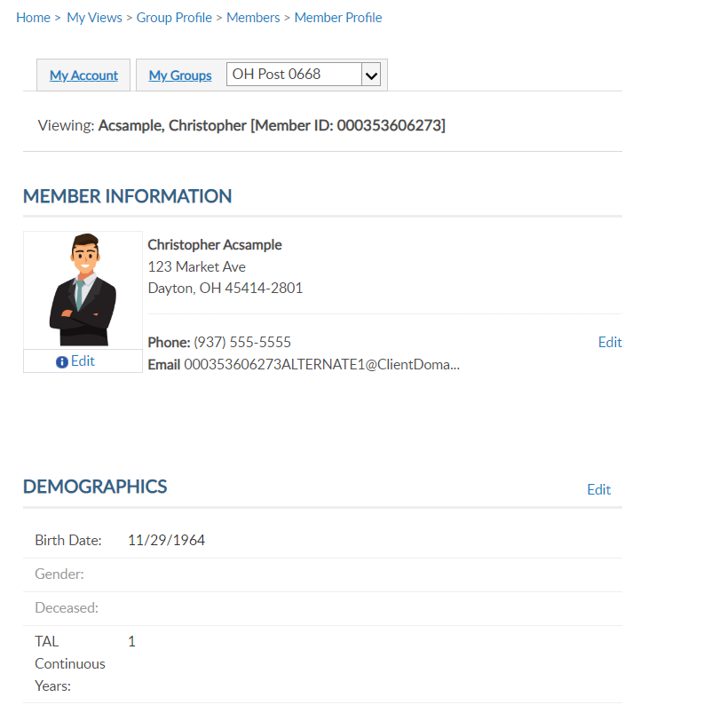
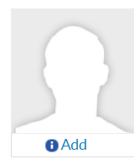
NAME & DEMOGRAPHICS
Viewing: Acsample, Christopher [Member ID: 123456789]
Address update only.
Christopher@yahoo.com
Notes:
The main view member page and have edit links <1> address, <2> phone number and email and <3> demographics. Date of birth, gender, deceased status and continuous years. The sections are separate. To update a member’s name, you must use the left menu option for Name & Demographics.

Slide 14
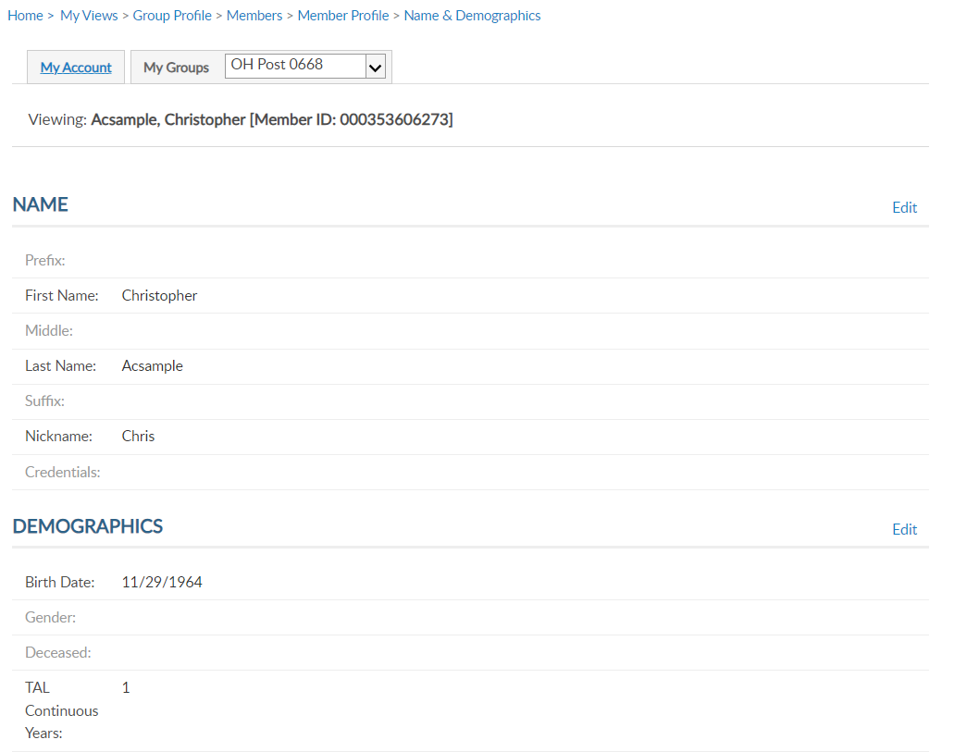
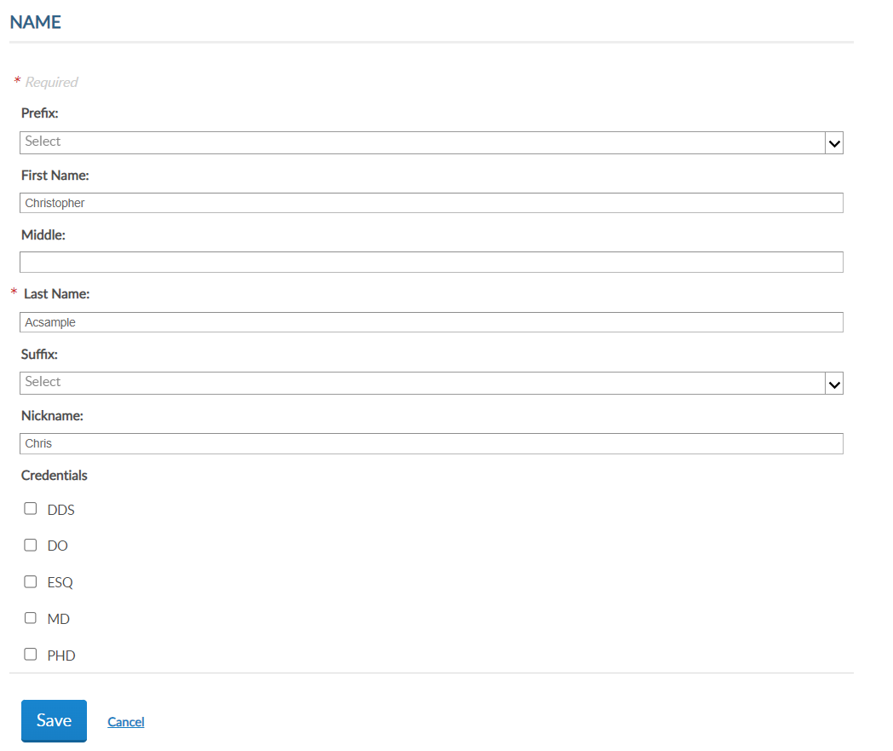
NAME & DEMOGRAPHICS
Viewing: Acsample, Christopher [Member ID: 123456789]
Viewing: Acsample, Christopher [Member ID: 123456789]
Viewing: Acsample, Christopher [Member ID: 123456789]
Notes:
This area has 2 sections, each with an edit button. Use the top edit button to edit name. <1> Always save when updates are made.

Slide 15
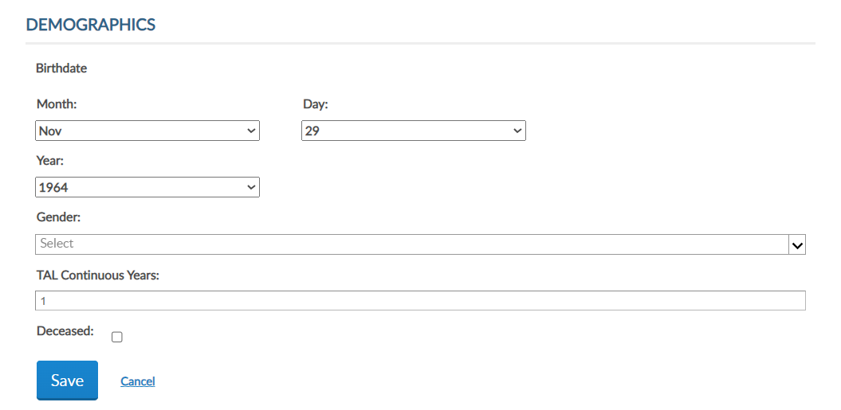
NAME & DEMOGRAPHICS
Viewing: Acsample, Christopher [Member ID: 123456789]
Viewing: Acsample, Christopher [Member ID: 123456789]
Viewing: Acsample, Christopher [Member ID: 123456789]
Notes:
To update date of birth, gender, continuous years and deceased status, click on the Edit button in the Demographics area. <1> Enter updates and Save. Please note, you cannot remove deceased status through MyLegion. If a member is flagged as deceased in error, contact your department headquarters.

Slide 16

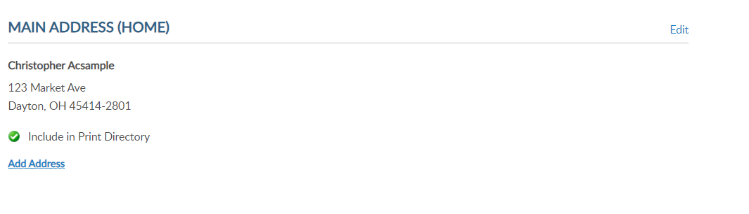
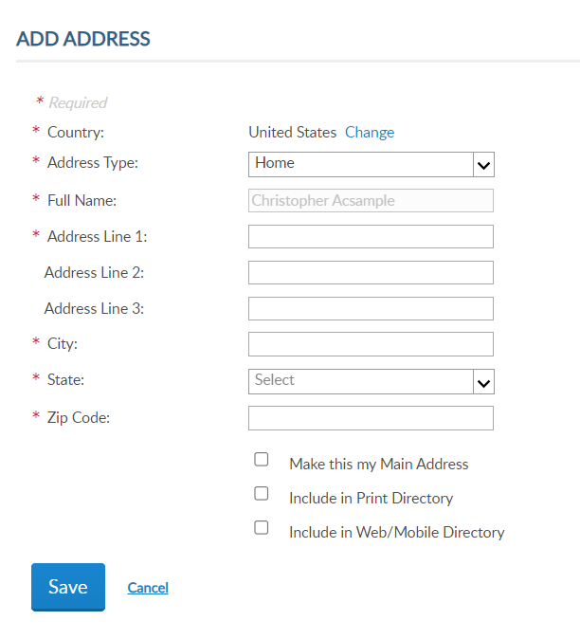
ADDRESSES
Viewing: Acsample, Christopher [Member ID: 123456789]
Notes:
Addresses allows you to update existing addresses or add an additional address to the member’s record. Members are required to have one main, or primary, address. The primary address listed on a member record determines where the address communications are sent for renewal notices, campaigns, and membership information. The main address cannot be deleted.
Some members may need an additional address on file for mailing subscriptions, or committee and officer correspondence. To add an additional address, click Add Address. <1> Selecting “Make this my main address” will make this your primary mailing address. Enter address information and save.

Slide 17
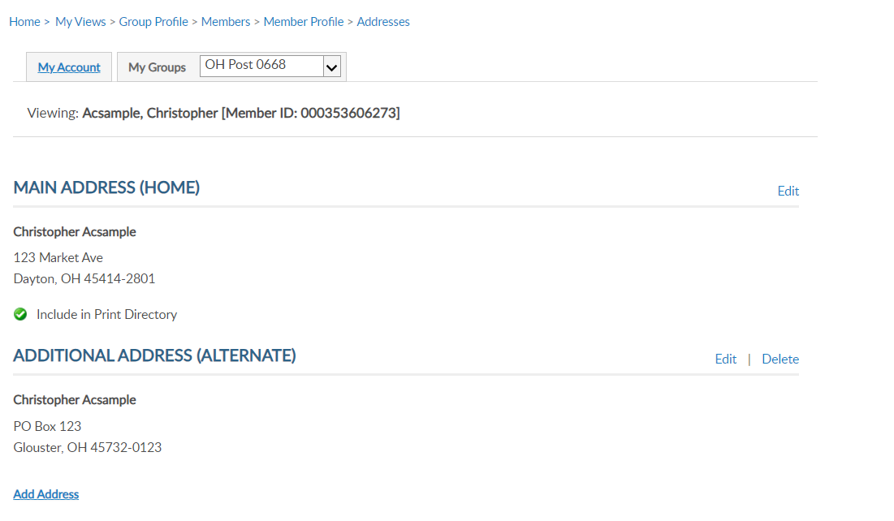
ADDRESSES
Viewing: Acsample, Christopher [Member ID: 123456789]
Notes:
The member record now has 2 addresses on file. Notice delete is now available. Delete only appears for alternate contact information.

Slide 18
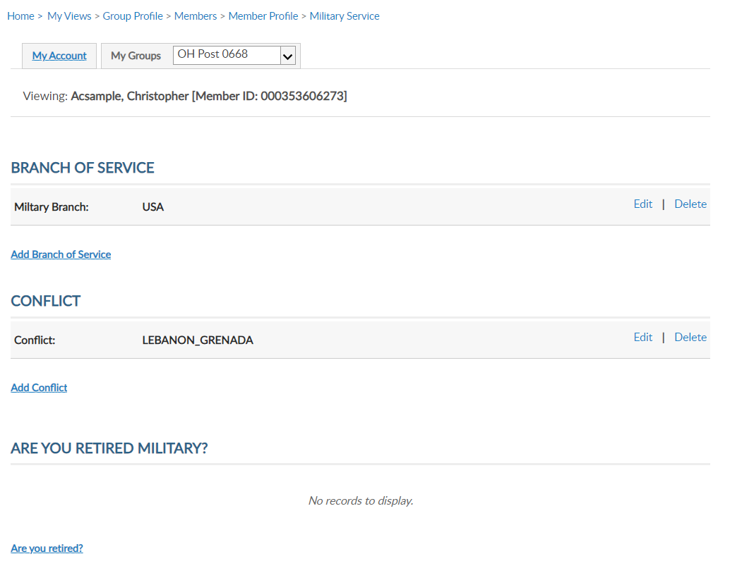
MILITARY SERVICE
Viewing: Acsample, Christopher [Member ID: 123456789]
Viewing: Acsample, Christopher [Member ID: 123456789]
Notes:
Military Service includes branch of service, conflict and retirement information.
MyLegion now allows multiple selections to be stored on the member record. Use the links to Edit, Delete or Add branch of service and conflict.

Slide 19
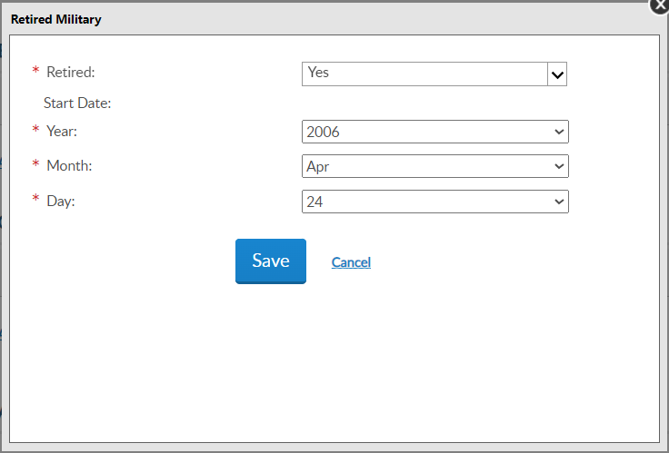
MILITARY SERVICE
Viewing: Acsample, Christopher [Member ID: 123456789]
Viewing: Acsample, Christopher [Member ID: 123456789]
Notes:
You can also store retirement information. To add retirement information, click on the link Are you Retired? <1> Enter the date retired and Save.

Slide 20
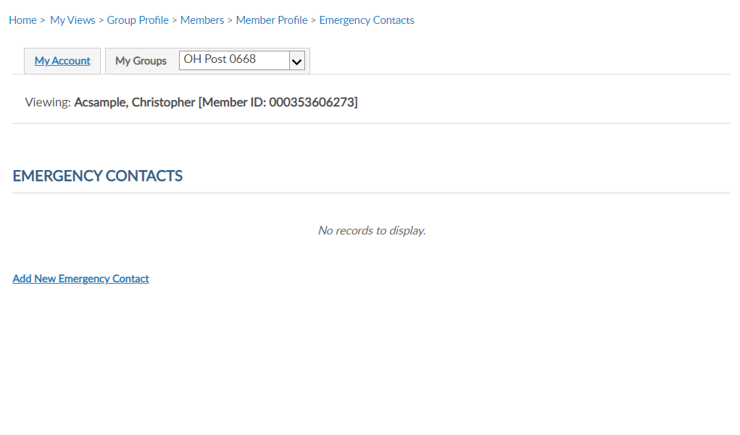
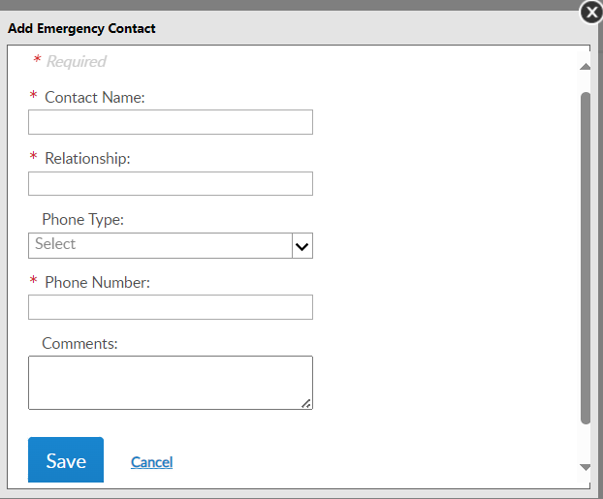
EMERGENCY CONTACTS
Viewing: Acsample, Christopher [Member ID: 123456789]
Viewing: Acsample, Christopher [Member ID: 123456789]
Notes:
Store emergency contact information in case of an emergency. <1> Enter emergency contact name, relationship, phone number, any comments and “Save”. - This information can be seen by department and national staff in case of an emergency if the member attends events and conventions or local activity of The American Legion or Sons of The American Legion.

Slide 21
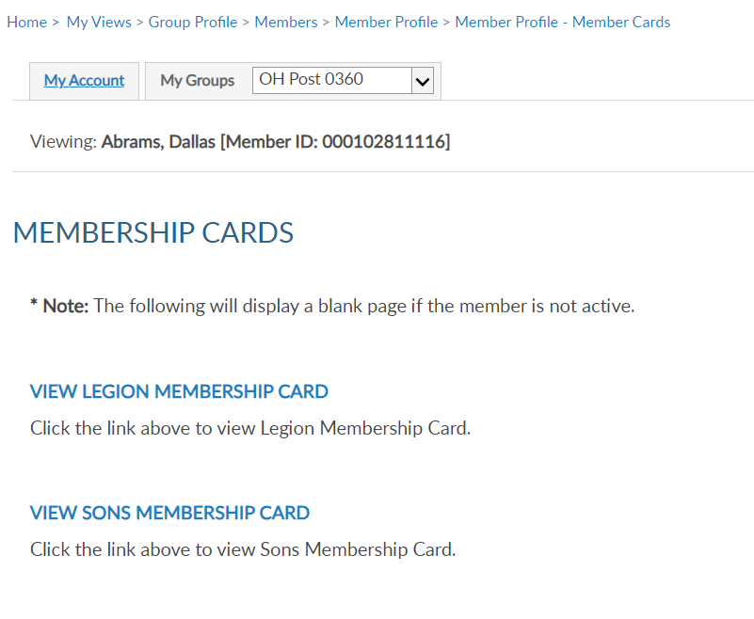
MEMBERSHIP CARDS
Viewing: Acsample, Christopher [Member ID: 123456789]
Viewing: Acsample, Christopher [Member ID: 123456789]
Notes:
Print a membership card for a member. Click the link to view membership card. <1> <2> Only current membership cards are available. This page will display as blank if membership is not active. Click on the link to view and print a card. Members who have both Legion and Sons of the American Legion members will have 2 options.

Slide 22
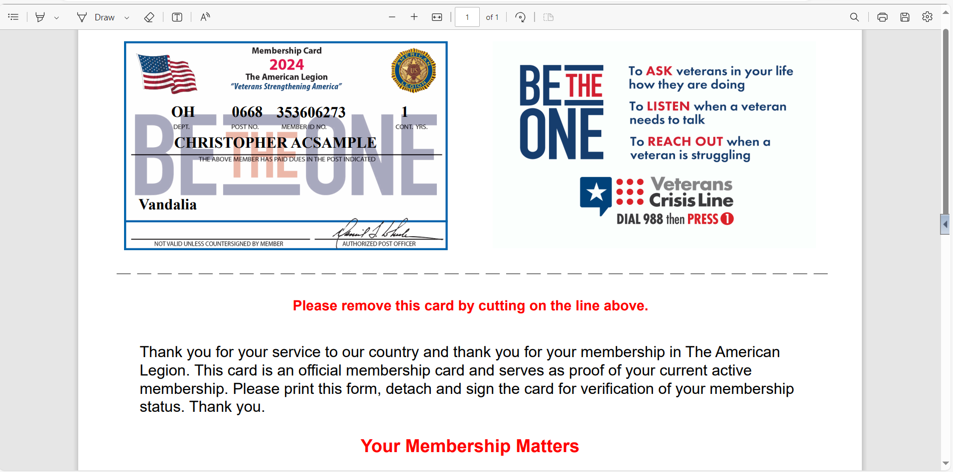
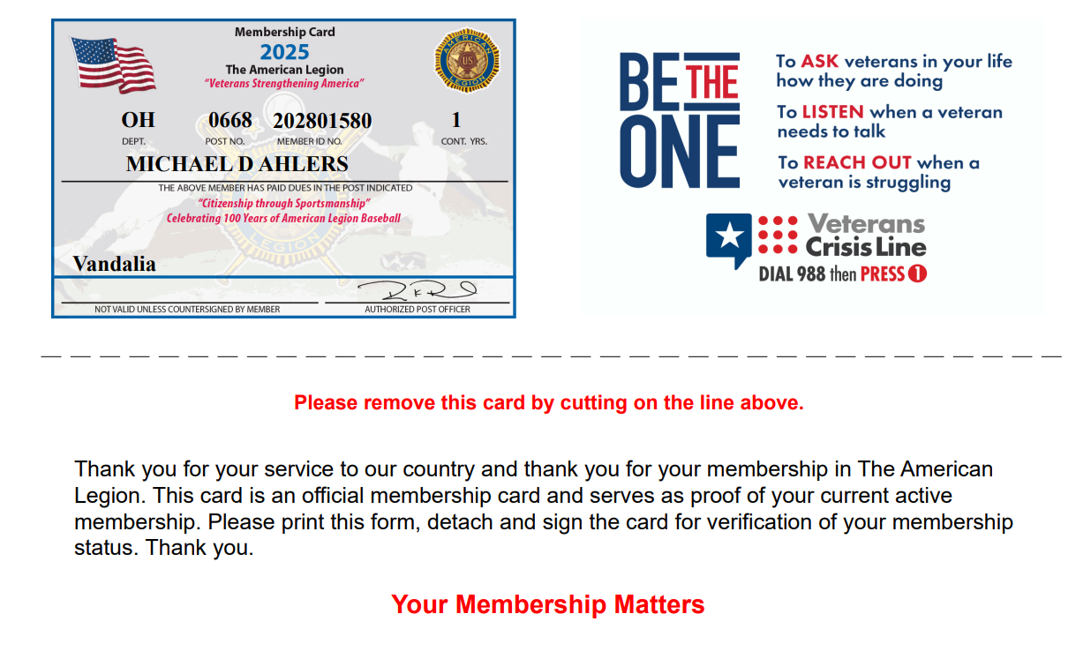
MEMBERSHIP CARDS
123456789
CHRISTOPHER ACSAMPLE
Notes:
A pdf document will open in your browser to save or print.

Slide 23
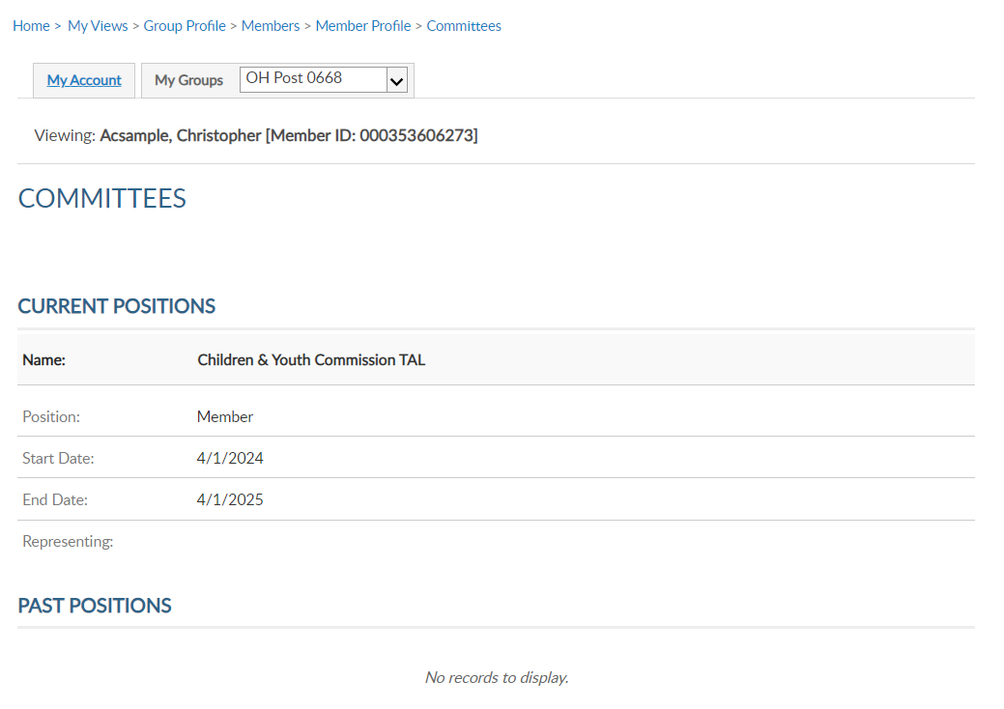
COMMITTEES
Viewing: Acsample, Christopher [Member ID: 123456789]
Viewing: Acsample, Christopher [Member ID: 123456789]
4/1/2026
Notes:
Committees lists offices held that are recorded on National’s membership system. It will display current and past positions.
This area is view only and reflects officers reported to National HQs. Officer updates are reported through your department using a post officers certification form. Incorrect committee information should be reported to your department.

Slide 24
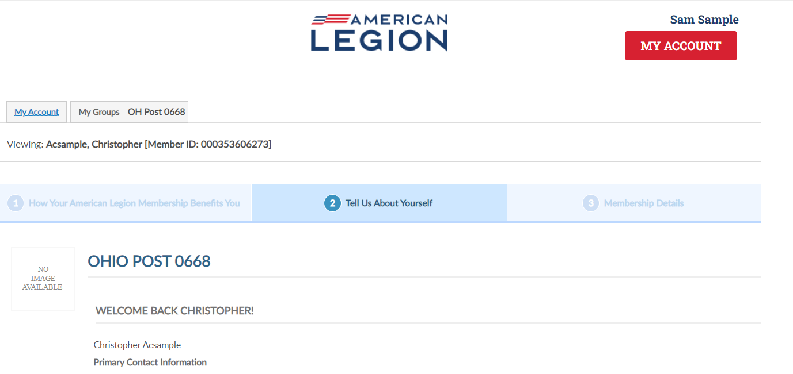
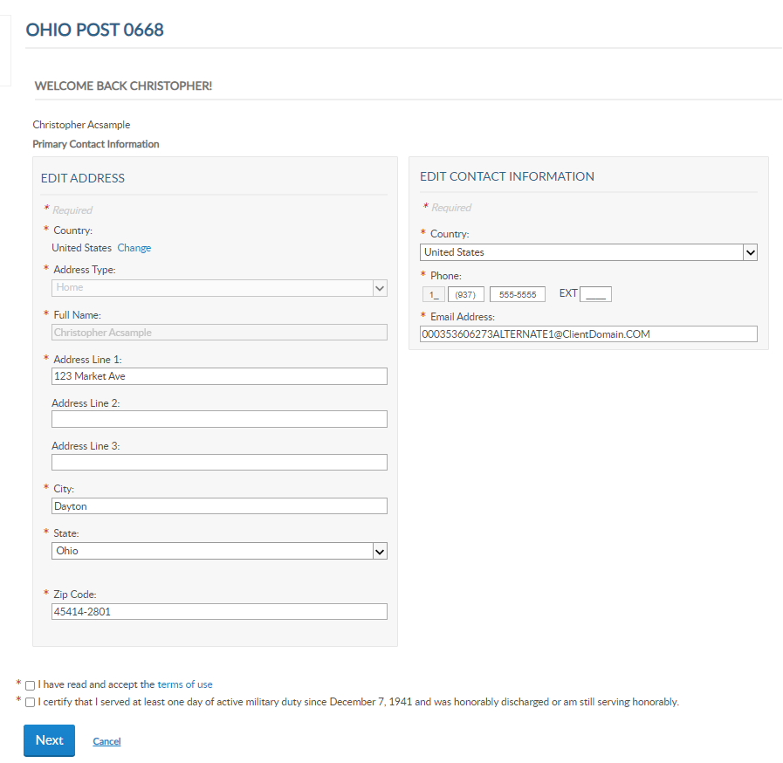
PAID UP FOR LIFE
Viewing: Acsample, Christopher [Member ID: 123456789]
Viewing: Acsample, Christopher [Member ID: 123456789]
Christopher@yahoo.com
Notes:
Paid up for life allows you to assist members with the online application.
Members that are already PUFL and expired members, will result in an error. Proceeding through the application provide the cost for PUFL membership either paid in full or using the 12-month payment plan.

Slide 25
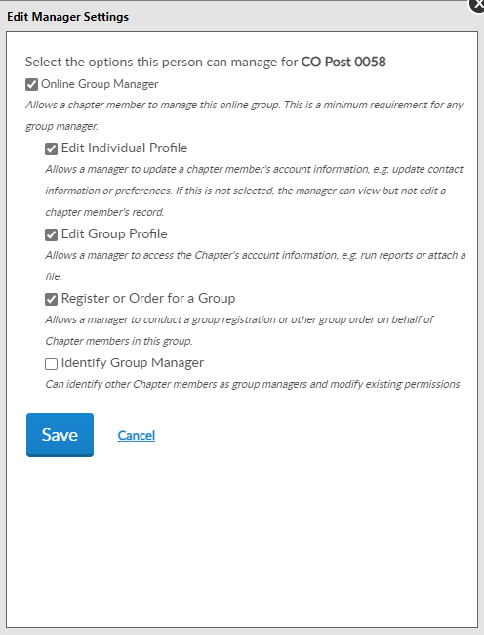
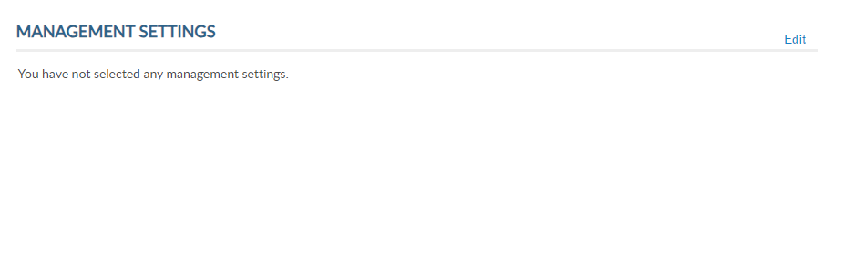
ASSIGN GROUP PERMISSIONS
Viewing: Acsample, Christopher [Member ID: 123456789]
OH Post 0668
Notes:
Assign group permissions should be used with caution. This tool allows adjutants and commanders to grant access to post and squadron membership to other members.
To add, delete or edit management settings, click edit. <1>

Slide 26
ASSIGN GROUP PERMISSIONS
OH Post 0668
Online Group Manager
Minimum Requirement
View and print member list.
Quick link to email address.
Notes:
To provide the same access adjutants and commanders have select:
Online Group Manager. This is the minimum permission requirement. It provides access to view members and a quick link to member email addresses. Selecting this option only results in view only and records cannot be updated.

Slide 27
ASSIGN GROUP PERMISSIONS
OH Post 0668
Edit Individual Profile
Edit member information
Edit Group Profile
Online Membership Tools: View Members, Global Member Lookup, Group Attributes, Reports/Labels, and Officer Materials.
Notes:
Check Edit Individual Profile to grant authority to add and edit member information. <1> Edit Group Profile provides access to View Members, Global Member Search, Group Attributes. Reports, Letters, Labels and Officer Materials.

Slide 28
ASSIGN GROUP PERMISSIONS
OH Post 0668
Register or Order for a Group
Allows online membership processing, Add/Modify Transmittal.
Identity Group Manager
ADJUTANTS AND COMMANDERS ONLY.
Notes:
Register or Order for a group is now the setting to allow other members to process membership online using Add/Modify transmittal. This permission allows the member to renew, transfer and add new members as well as update payment information.
<1> The last setting is only available to adjutants and commanders. This setting allows the member to provide management settings for other members.
After the desired management settings are assigned, click on the Save button.

Slide 29
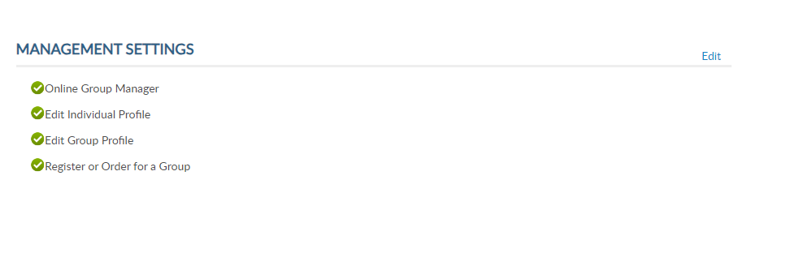
ASSIGN GROUP PERMISSIONS
Viewing: Acsample, Christopher [Member ID: 123456789]
* Monitor access using MyLegion Access report.
* Contact department headquarters to add end date.
Notes:
Permissions added will display. The next time the member logs into their myLegion account, they will have access group membership.
Select back to view members to search more names or select Group Profile to return to the group home page.
No end date is set when applying these permissions. Permissions can be removed by returning to Edit and unchecking the selections. It is important to keep track of anyone given permissions.
<1> You can monitor members with access to your group in MyLegion in reports. Learn more about reports in Find Help. <2> To ensure members with permissions are monitored we suggest you contact your department headquarters or MyLegion support team to add an end date. Adding an end date will remove permissions to allow any new officers or existing officers to review the members administrative needs and re-assign if needed.
<3> Click Back to View Members to return to the member listing.

Slide 30
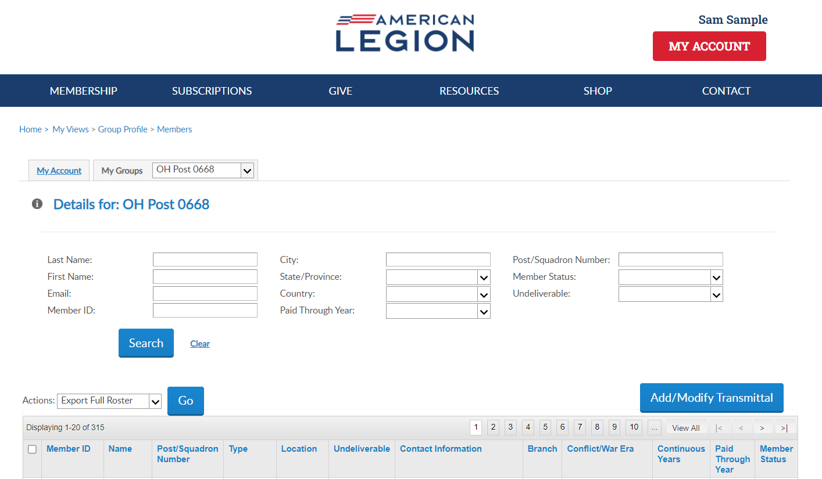
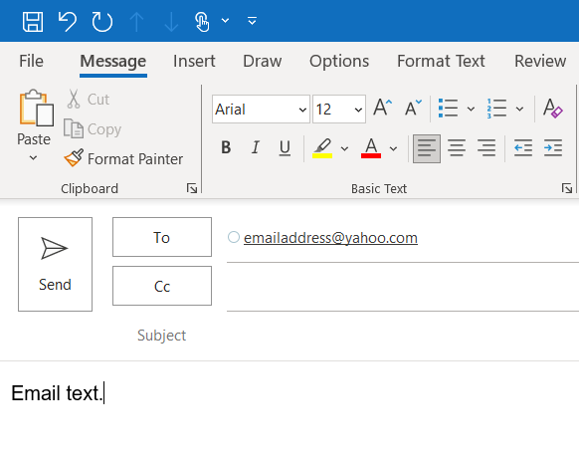
EMAIL MEMBERS
123456781 | AaExample, James | American Legion OH Post 0668 | 1 Year Membership | Address |  | email address Phone | USAF | VIETNAM | 5 | 2024 | Expired
123456782 | AaExample, Jr, Fred | American Legion OH Post 0668 | PUFL renewal | Address |  | Phone | USAF | KOREA | 49 | 2025 | Active
123456783 | AaSample, Allen | American Legion OH Post 0668 | Post Transfer | Address |  | email address Phone | USA | VIETNAM | 20 | 2025 | Active
Notes:
Emails can be sent from MyLegion. From the View Members listing, you can search a member, or a group of members and send an email.
To email and individual member, search them and click on the email hyperlink. <1> This opens your email browser to write and send an email.
The default email browser is Microsoft Outlook. If you are using another browser such as gmail or yahoo, it will be required to set your browser-based email default preference.
The number of records emailed at one time and per day is also limited per the email client. Generally, 100 per email and 500 per day. Check with the email client for limitations.

Slide 31
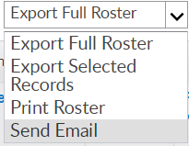
Email a Group of Members
EMAIL MEMBERS
123456781 | AaExample, James | American Legion OH Post 0668 | 1 Year Mbrship | Address |  | email address Phone | USAF | VIETNAM | 5 | 2024 | Expired
123456782 | AaExample, Jr, Fred | American Legion OH Post 0668 | PUFL renewal | Address |  | Phone | USAF | KOREA | 49 | 2025 | Active
123456783 | AaSample, Allen | American Legion OH Post 0668 | Post Transfer | Address |  | email address Phone | USA | VIETNAM | 20 | 2025 | Active
*
*
*
Notes:
Email a group of members by first selecting the records. The search fields allows you to filter the data. Search the members to email. <1> Click View All. <2>Check all names in the list by clicking the checkbox in the title row. Using the Actions menu, <3> choose Send Email and click Go.

Slide 32
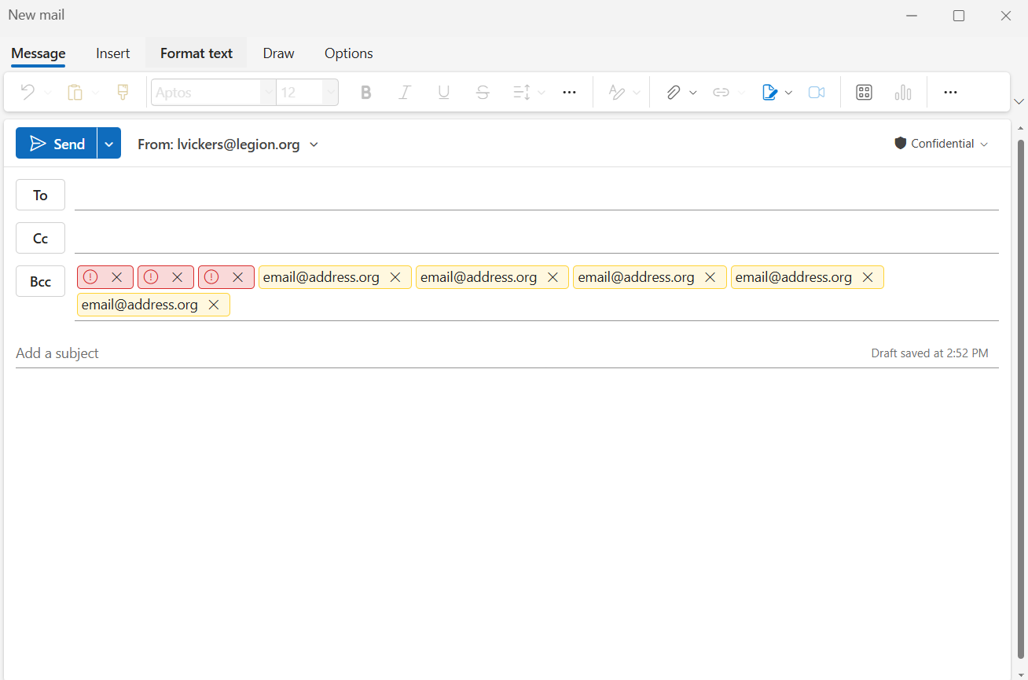
Group Email
Notes:
Emails are sent through MS Outlook.

Slide 33
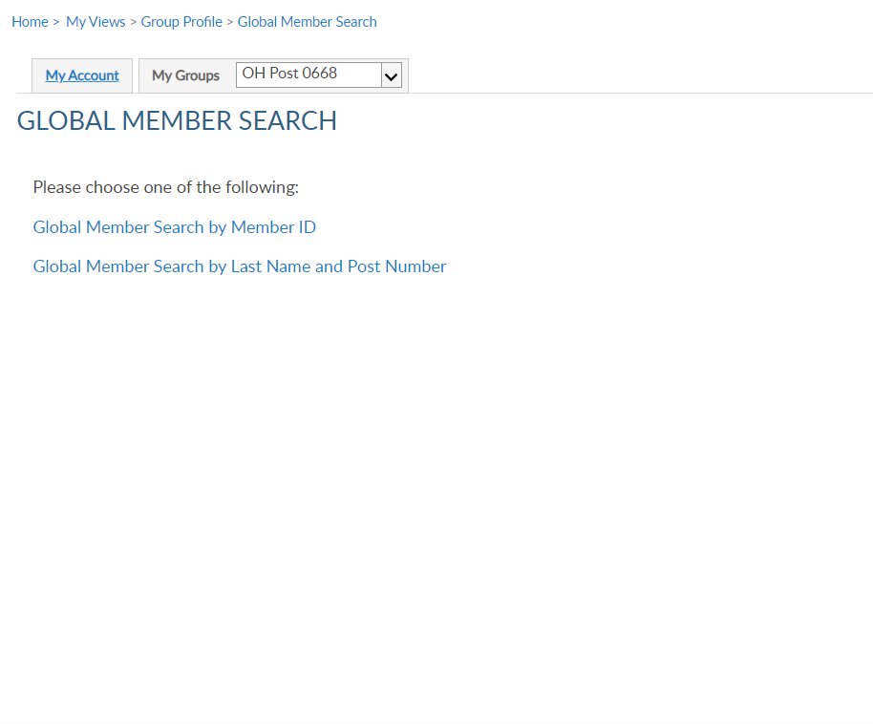
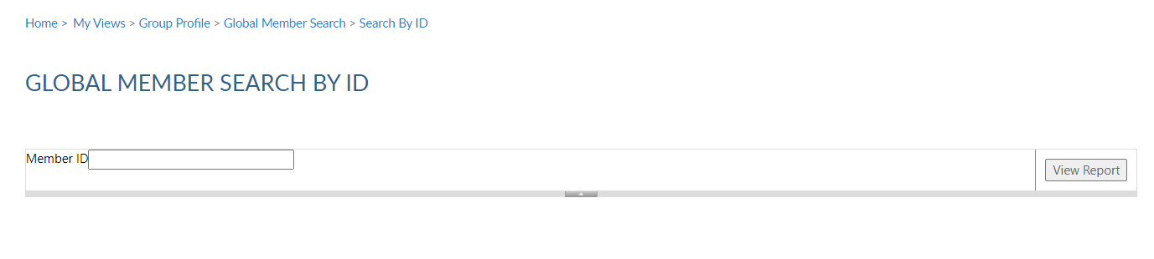
IMPORTANT INFO
Notes:
Global member search allows you to view members outside of your group. 2 options are provided. Search by ID or search by name with post number.
<1> Search by ID allows you to enter a Legion or Son of The American Legion membership number to view limited information. Enter the ID#, click View Report <2> to view name, member type, paid post or squadron, and last paid year.

Slide 34
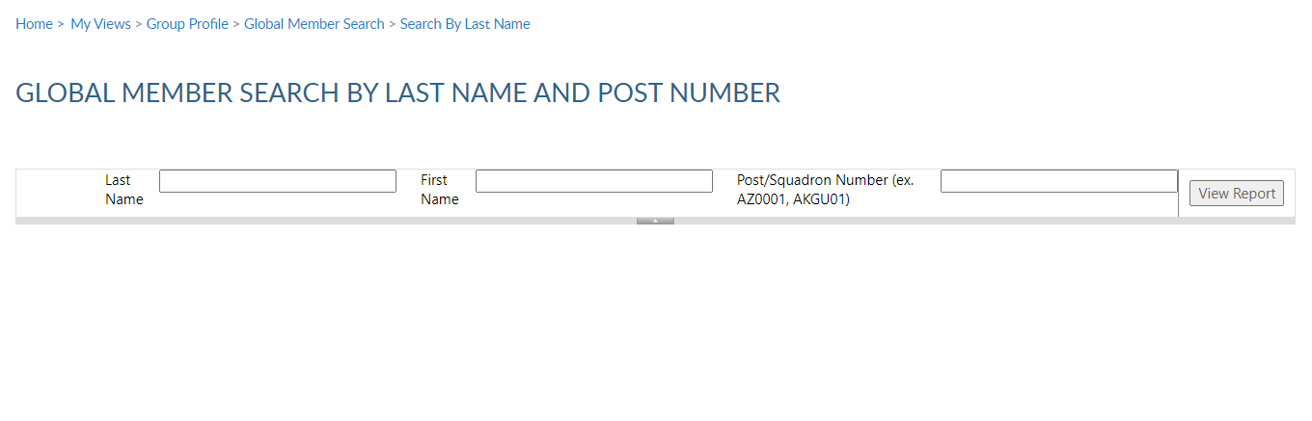
IMPORTANT INFO
Notes:
Search by last name and number requires both pieces of information. Click View Report to view. <1>
This information can assist with transferring members and eligibility for The American Legion Auxiliary and Sons of the American Legion.

Slide 35
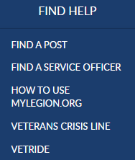
emailaddress@yahoo.com
000123456789
Expired
000123456789
Notes:
Online help is available from the top Menu “Find Help”.
Step by step instructions, videos and training presentations will assist with how to manage groups in MyLegion.

Slide 36
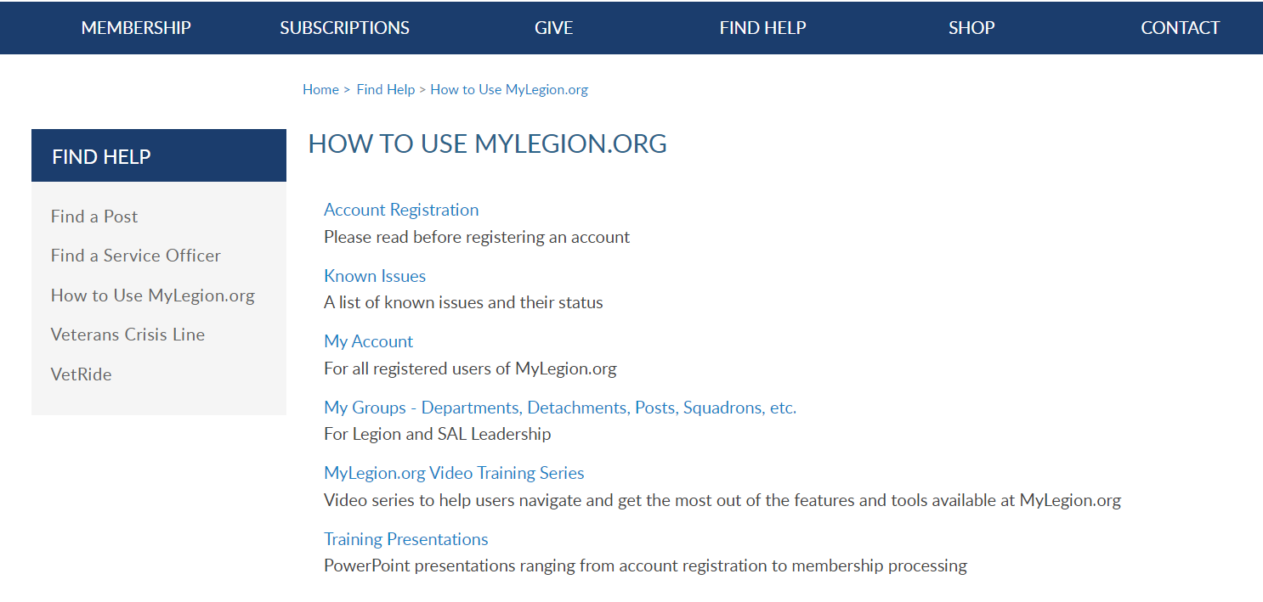
Online Help
Notes:
Step by step instructions, videos and training presentations will assist with how to manage groups in MyLegion. My Groups instructions include managing membership, online, membership processing, reports and all other administrative tasks.

Slide 37
MYLEGION SUPPORT
MyLegion@legion.org
833.253.9995
Monday – Friday
8:00am – 4:30pm
(Eastern)
The American Legion National HQs
5745 Lee Road
Indianapolis, IN 46216
Contact your MyLegion support team to assist with any questions or tools on your MyLegion account.
Notes:
Contact your myLegion support team to assist with questions and tools for MyLegion. Email mylegion@legion.org or call 833-253-9995 Monday through Friday.

